Slide 1

Oceans in Peril
Climate Change Impacts on Marine Ecosystems
Analyzing the Anthropogenic Drivers of Ocean Warming, Acidification, and Biodiversity Loss.

Slide 2

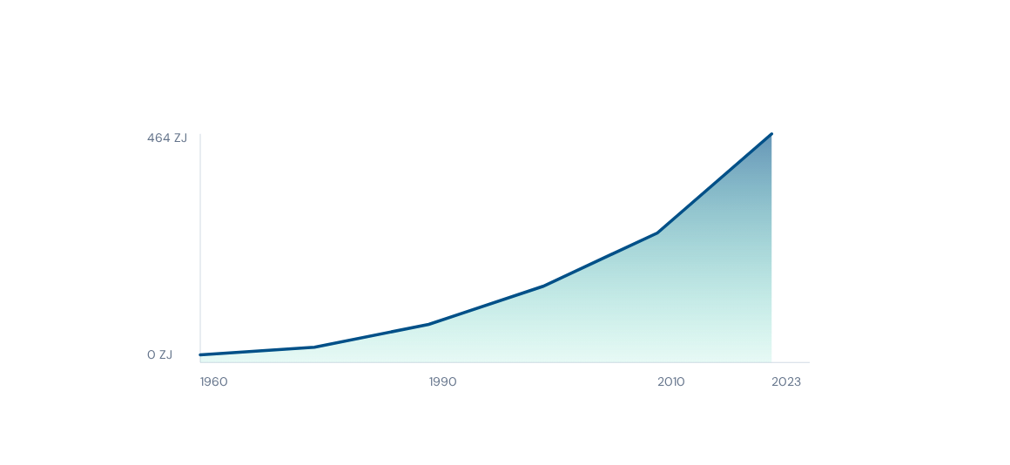
Rising Global Ocean Heat Content
The ocean stores approximately 91% of the excess heat energy trapped in the Earth's system. Heat gain is accelerating, reaching record levels of 464 ± 55 ZJ in 2023.
Source: World Meteorological Organization (WMO) 2024 Report

Slide 3
Ecosystem Fragility
Coral Bleaching Crisis
Coral reefs support 25% of all marine species. Recurrent thermal stress causes corals to expel symbiotic algae, leading to bleaching and mass mortality.
Current models predict that even with a 1.5°C limit on global warming, 70-90% of coral reefs may disappear by 2050. At 2.0°C, the loss exceeds 99%.

Slide 4



The Invisible Crisis: Acidification
Chemical Shifts
Impact on Calcifiers
The ocean absorbs ~25% of annual CO2 emissions. This alters seawater chemistry, leading to a decrease in pH and carbonate ion availability.
Lower carbonate levels impede the ability of organisms like corals, oysters, and pteropods to build their calcium carbonate skeletons and shells.
•
Reduced shell strength and density
•
Increased energy expenditure for maintenance
•
Disruption of the entire marine food web

Slide 5






Pathways to Marine Resilience
Marine Protection
Blue Carbon
Tech Monitoring
Expanding Marine Protected Areas (MPAs) to cover 30% of global oceans to allow ecosystem recovery and foster resilience against climate shocks.
Restoring coastal ecosystems like mangroves, seagrasses, and salt marshes that sequester carbon up to 10 times faster than terrestrial forests.
Utilizing AI-driven data from Argo floats and satellite imagery to track thermal anomalies and predict bleaching events in real-time.

Slide 6


Image Sources
https://images.stockcake.com/public/e/c/9/ec98d5a1-8c1d-47eb-b746-3e6c9b959ccd/serene-coral-ecosystem-stockcake.jpg
Source: stockcake.com
https://img.freepik.com/free-photo/underwater-light-rays_84443-83960.jpg?semt=ais_hybrid&w=740&q=80
Source: www.freepik.com

